Slide 1
Plan, Design, Develop, and Test Report Application
Module Project
Module: NICF-Application Implementation (SF)
Course:
Start Date : 9 August 2022
End Date : 24 August 2022
Submission Date : 23 August 2022
Learner Name : Wildan Luqmanul Hakim
Enrollment ID : BDSE-0322
Presentation Date :

Slide 2
Contents
Document History
Version Number | Effective Date of release | Summary of Included Changes | Author
1 | 4th March 2016 | First Edition | Satya CVS
2 | 23rd Jul 2018 | Changed for Module 6 | Shrinivas K R

Slide 3
Contents
Contents
S. No. | Description
01 | Different Types of Testing
02 | How Different Testing Helps
03 | Tests Selected
04 | Test Schedule
05 | Test Results
06 | Testing Tools
07 | Project Milestone & Tasks
08 | Milestone Feedback & Action Taken
09 | Modifications Made Based on Feedback
10 | Project Results
11 | Proposed Improvements

Slide 4
1. Different Types of Testing
List types of Testing
Unit Test Unit tests are very low level and close to the application's source code. They consist of testing individual methods and functions of your software's classes, components, or modules. Unit tests are typically inexpensive to automate and can be run quickly by a continuous integration server.
Integration Test Integration tests ensure that your application's various modules or services work well together. It could be testing the interaction with the database or ensuring that microservices work together as expected.
Functional Test Functional tests are concerned with an application's business requirements. They only check the output of an action and do not examine the system's intermediate states while performing that action.
End-to-end Test End-to-end testing simulates a user's interaction with software in a complete application environment. It verifies that various user flows work as expected and can be as simple as loading a web page or logging in or much more complex scenarios such as verifying email notifications, online payments, and so on.

Slide 5
1. Different Types of Testing
User Acceptance Testing Acceptance tests are formal tests that determine whether a system meets business requirements. They require that the entire application be running while testing and concentrate on replicating user behaviors.
Performance Testing Performance tests assess how a system performs in response to a specific workload. These tests help to assess an application's dependability, speed, scalability, and responsiveness.
Smoke Testing Smoke tests are simple tests that check an application's basic functionality. They are designed to be quick to execute and provide assurance that the major features of your system are functioning properly.

Slide 6
2. How Different Test Helps
Write briefly on how different tests helps
Unit Test
Unit testing saves time and money
Unit testing helps gauge performance
Unit testing improves code coverage
UAT Testing
To confirm that the software product can perform all the business functions.
To confirm that the software product is usable from the end-users perspective.
To certify that the software product is ready to move to production.

Slide 7
3. Tests Selected
List the testing methods selected to test the project
Unit Testing
UAT Testing

Slide 8
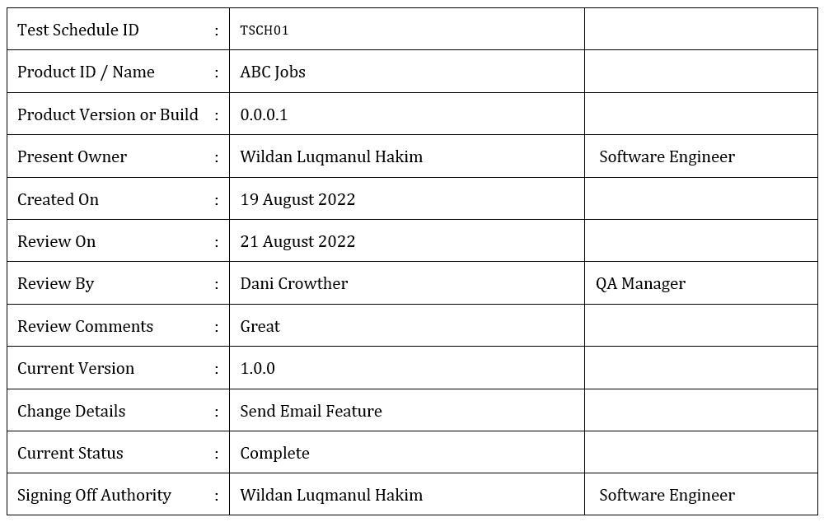
4. Test Schedule
Create an optimal test schedule

Slide 9
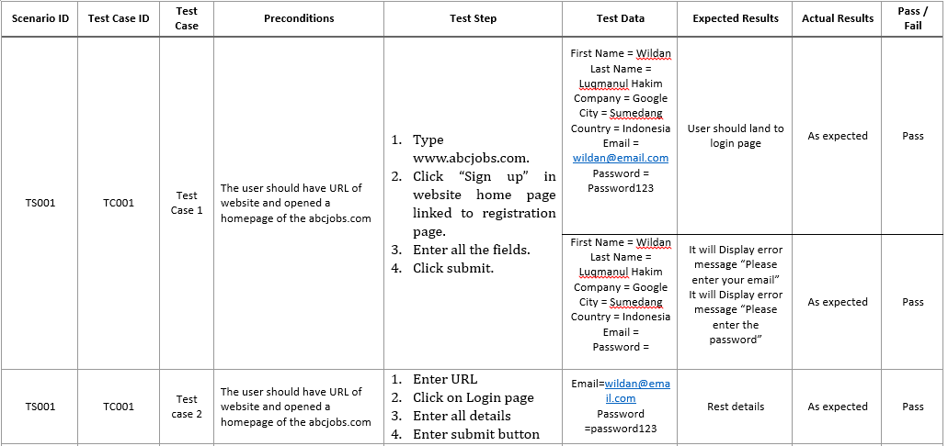
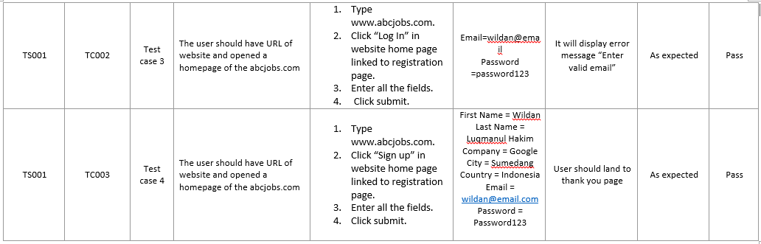
5. Test Results
Unit Test

Slide 10
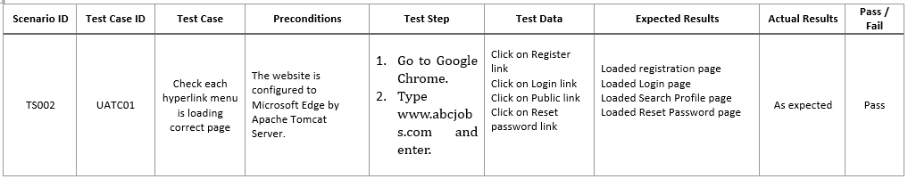
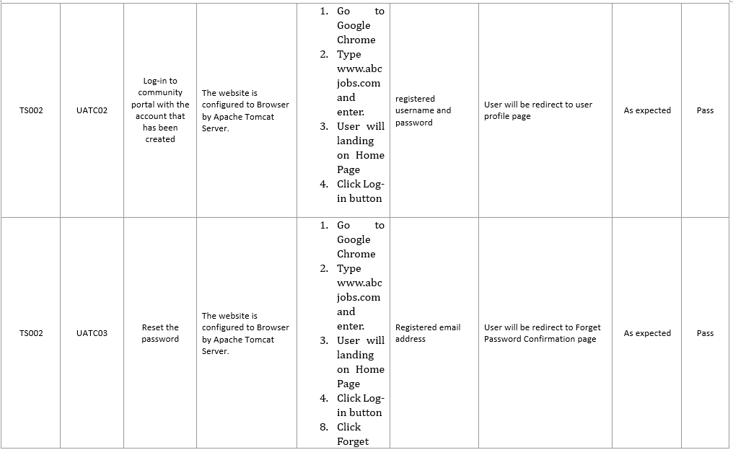
5. Test Results
UAT Test

Slide 11
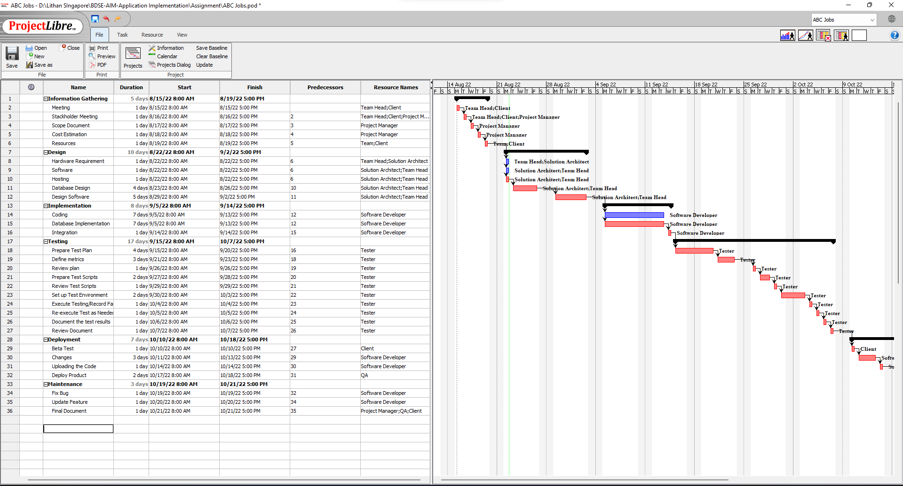
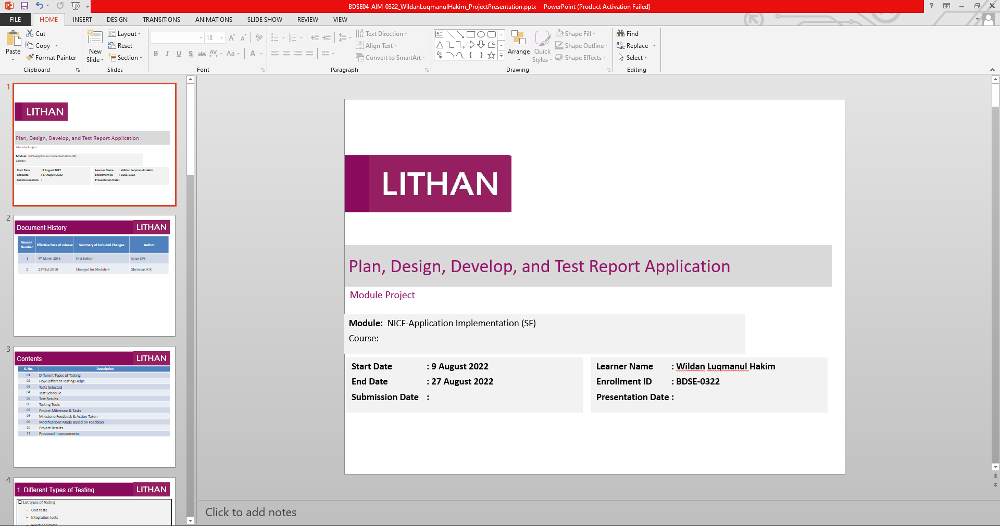
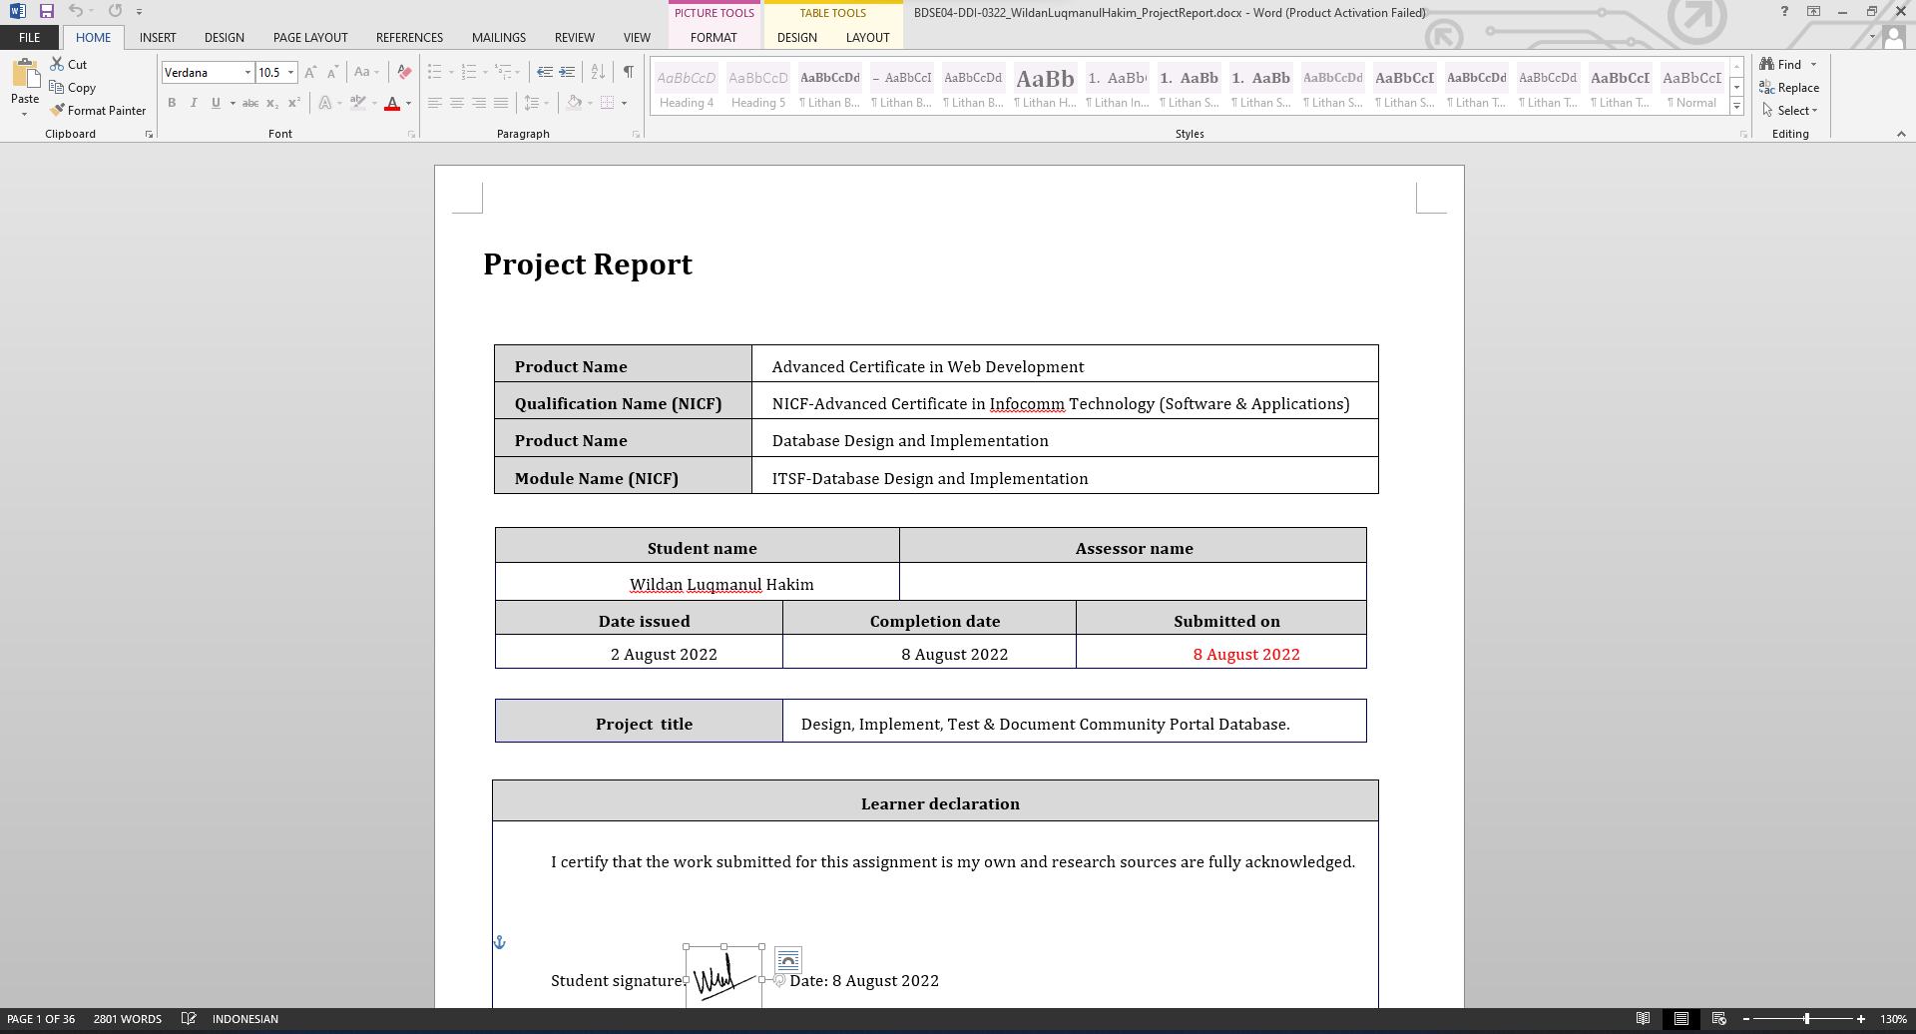
6. Testing Tools
ProjectLibre
Microsoft PowerPoint
Microsoft Word

Slide 12
7. Project Milestones & Tasks
Project Task ID | Project Task Description | Project Milestone ID
1 | Analyze and suggest choice of Test Methods | 1
2 | Schedule the Test Optimally | 1
3 | Develop the Phase Test Plan | 1
5 | Develop Test Cases & Scripts | 2
6 | Execute the Tests & Document the results | 3

Slide 13
8. Milestone Feedback & Action taken
Project Milestone ID | Milestone Feedback received from Tutor / Learning Facilitator | Action Taken (Yes / No)
1 | Mention all of type in Waterfall model | YES
 | Delete requirement that are not included in Non-Funcional Requirements | YES
 | Update Project Background | YES
 | Update Database | YES
2
3

Slide 14
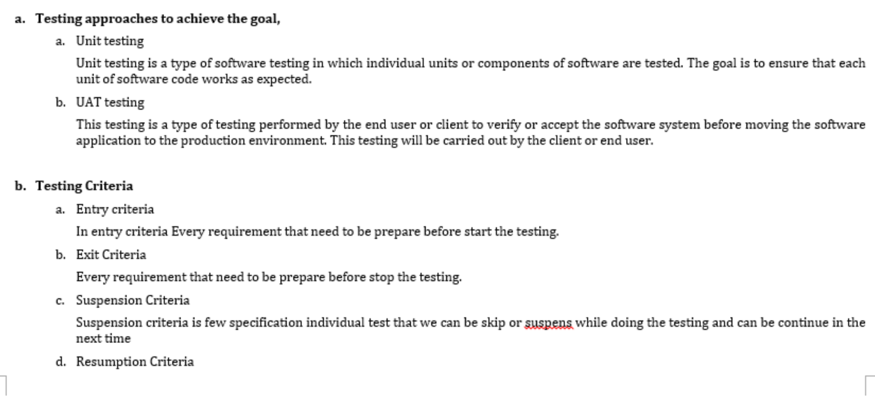
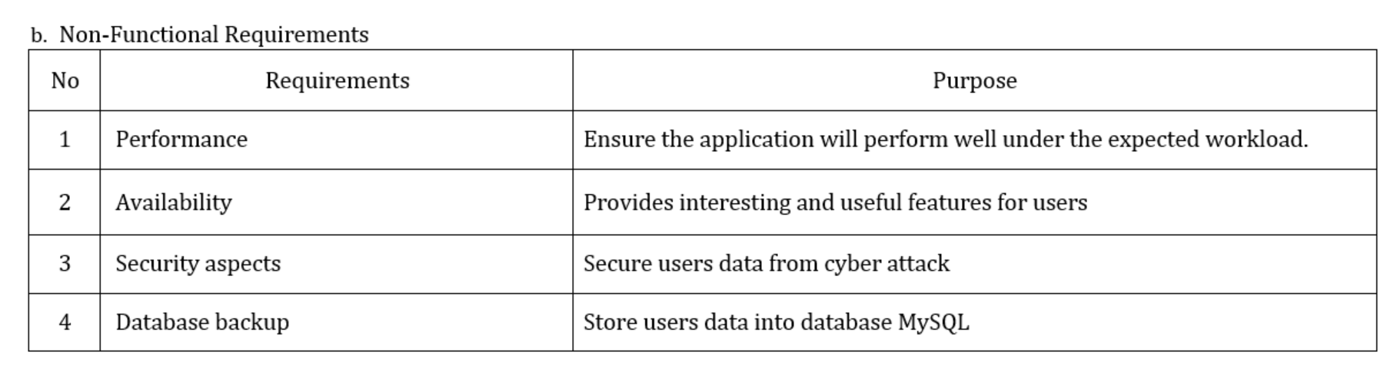
9. Modifications Made based On Feedback

Slide 15
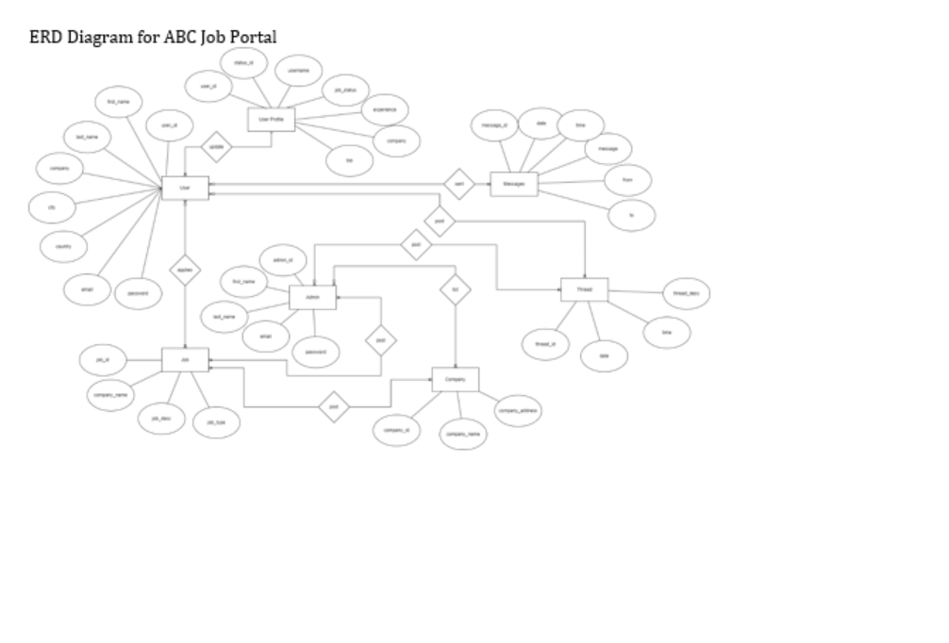
9. Modifications Made based On Feedback

Slide 16
10. Project Results
Unit Test

Slide 17
10. Project Results
UAT Test

Slide 18
11. Proposed Improvements
List of Improvements
Update a waterfall model specifically and in accordance with the plan
Try use other SDLC Model and compare with Waterfall model

